Slide 1
“Three months in”
The impact of the coronavirus on the UK bid & proposal profession
Snapshot survey - findings
Jon Williams FRSA CPP APMP Fellow FISM
Managing Director, Strategic Proposals
© Strategic Proposals 2020

Slide 2
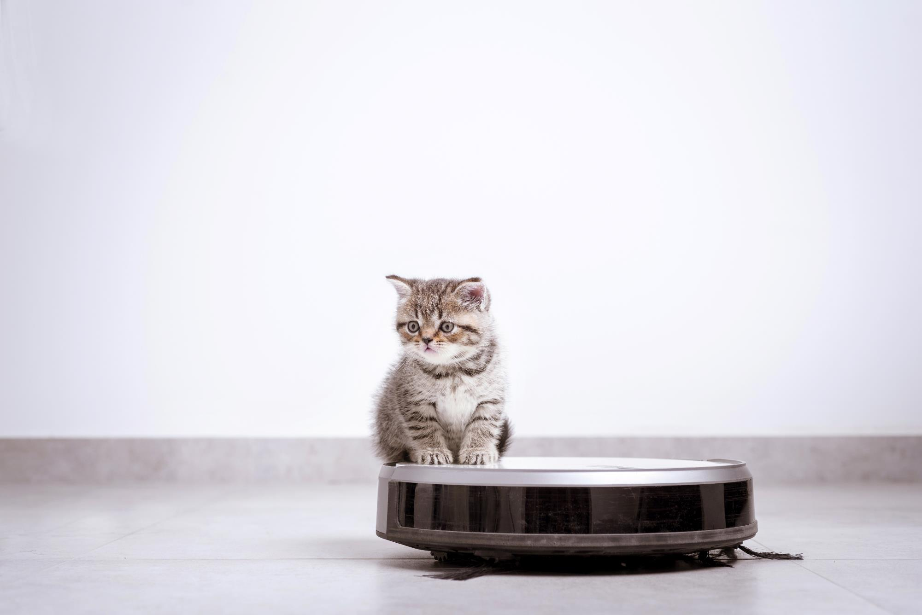
Why this survey?

Slide 3
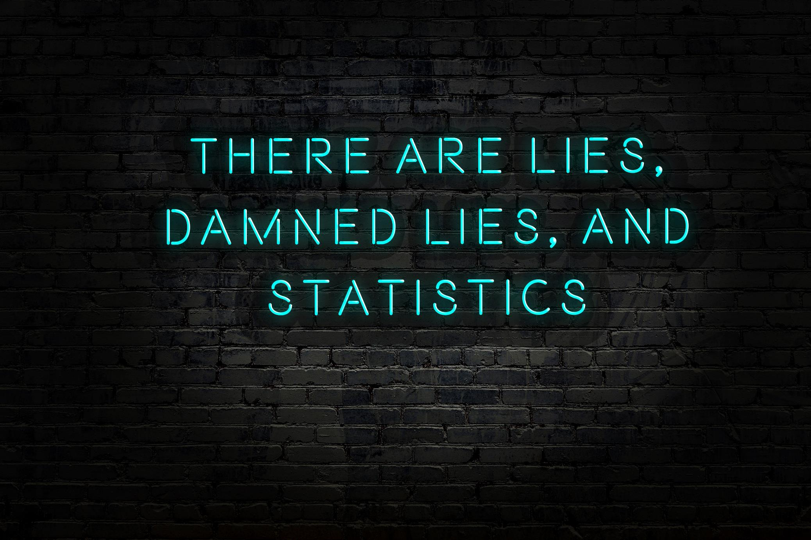
“Indicative, rather than statistically significant”

Slide 4

Too many words!

Slide 5


Which of the following best
describes you?
I’m employed in an in-house proposal team
I'm an external provider of bid/proposal expertise (e.g. consultant, contractor, freelancer)

Slide 6
Have you seen any change to the volume of RFPs / ITTs you've been receiving over the past three months?
Some sectors have been really busy!
A third of respondents have seen a significant decline in RFP volumes

Slide 7
How busy do you expect to be working on proposals during the remainder of 2020?
0% (no work at all) / 100% (same as normal)
On average, expecting to be 6% busier than usual
One third of respondents expecting to be quieter than usual
Over a quarter expecting to be 40%+ busier than usual

Slide 8
Which of the following have you experienced personally?
Being furloughed

Slide 9
Which of the following have you experienced personally?
Being furloughed
41% of respondents

Slide 10
Which of the following have you experienced personally?
Cut in working hours

Slide 11
Which of the following have you experienced personally?
Cut in working hours
20% of respondents

Slide 12
Which of the following have you experienced personally?
Cut in salary

Slide 13
Which of the following have you experienced personally?
Cut in salary
32% of respondents

Slide 14
Which of the following have you experienced personally?
Redundancy

Slide 15
Which of the following have you experienced personally?
Redundancy
13% of respondents

Slide 16
How will the crisis impact the work you undertake alongside live bids / proposals during the remainder of 2020?
(e.g. training, pre-written content, recruitment)
Some significant cuts in investment & effort in capability improvement work
Those who don’t invest in their capabilities risk falling (further?) behind

Slide 17

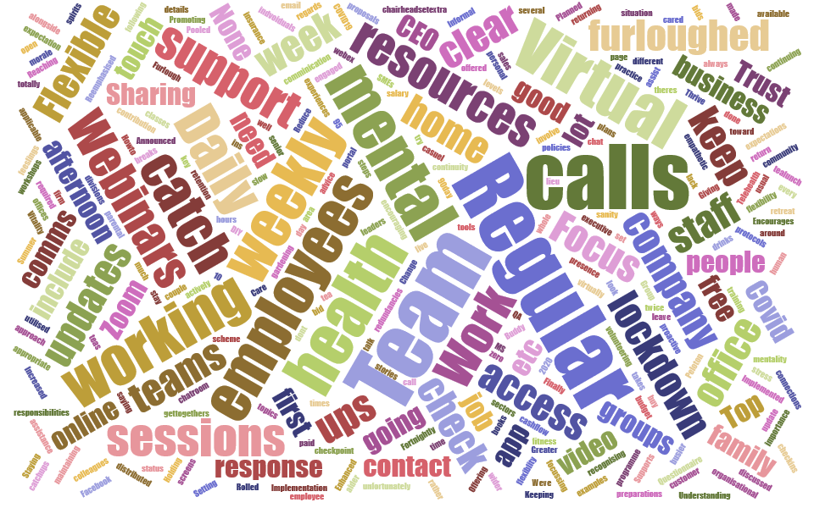
What have been the most valuable steps your organisation has taken during over the past three months to promote wellbeing in your bid / proposal community?

Slide 18
Regular team calls (daily / weekly / fortnightly)
Announced zero redundancies in 2020
Buddy groups
Budget to buy office chair / headset / extra screens as required
Change in company policies to support parental responsibilities / volunteering
Chatrooms where topics include gardening, DIY and top books
Engaged and empathetic leadership
Extending wellbeing resources to include whole family
Focus on proactive proposals
Free fitness classes, yoga, access to Peloton
Implementation of 10% of working week as paid leave

Slide 19
Live Q&A sessions with the CEO
Mental health & wellbeing workshops, resources, apps, first aiders
Promoting training and webinars
Questionnaire about colleagues' feelings toward returning to the office
Social activities: quizzes, bingo, virtual pub lunches & afternoon teas
Regular updates from leadership on situation and response
Setting up a Facebook page for all employees who’ve been furloughed
Support for flexible working
Trust
We've not been furloughed despite the lack of bids
None. They furloughed us all and there’s been no further comms.

Slide 20

People talk about the “new normal” that will emerge after the current crisis. How do you think the “new normal” will be different in relation to bids and proposals?

Slide 21
“Home working all the way, baby!”
We’ll need clarity on when face-to-face collaboration will be necessary – and to get much better at it!
“Previously our team worked 1-2 days per week from home. Going forward, I can see that changing to 1-2 days in the office.”
“The war for talent will shift as people (especially the younger generation) desire more flexibility.”
“Harder to get that critical face to face time with prospects - to build up a rapport and a trusted relationship with your buyers.
We'll need to think of ever more creative ways to bring our bids to life. And convincing people to make that big move will be even tougher...”
“Undecided as to whether companies will take work more in-house or if there will be more consultancy..”

Slide 22

Changes in client behaviours, processes or RFP questions
A handful of responses…
“Determined to proceed”
“Fast-tracking” plans
Varies by sector

Slide 23

“Delays” and “postponement”
“A reluctance to commit”
“Fewer meaningful decisions are being made”
Heightened need for effective qualification

Slide 24

“Procurement visibly struggling”
“Unsure of what they want”
“Lots of ambiguity”
“More reserved / wary”

Slide 25

Not issuing tenders and extending with incumbents
Renewals becoming more commonplace
More work coming from existing clients - better to focus here than on new names
Huge opportunity for renewal and proactive proposals

Slide 26
Timescale impacts
Bid
Proposal
Shorter
Decision
(if project not abandoned)
Decision
(if project not abandoned)
Prolonged evaluation
Longer
Extensions

Slide 27
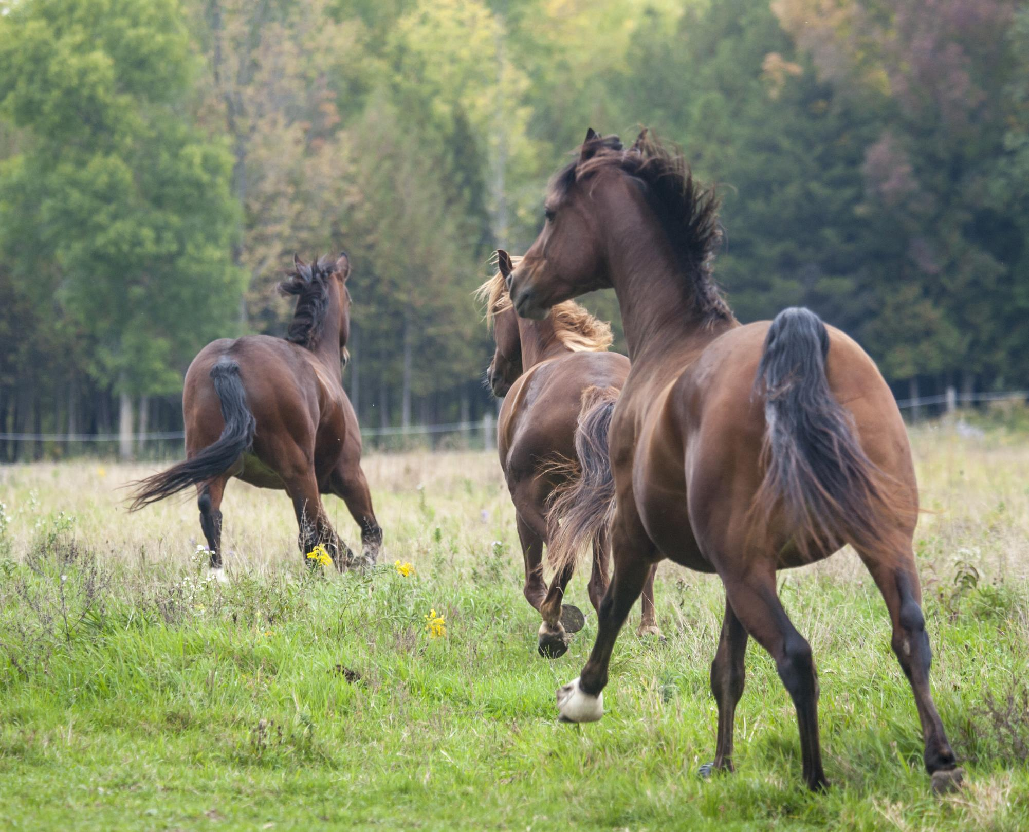
RFx questions
Increased focus on:
COVID-19
Business continuity more generally
Price & cost
Remote working
IT security
Social value
Diversity
Wellbeing
Need for new pre-written content!

Slide 28

If you’ve not quickly mastered virtual pitching, you’re in trouble

Slide 29

Describe a moment from lockdown that will stay with you forever
Mum surviving Covid, and the emotional rollercoaster that came with it. When the negative feelings of helplessness, fear, sadness and panic were slowly replaced by reassurance, hope, and joy when that good news call came, it felt like a big warm hug directly from the NHS. No idea how she beat it, but the day that call came "she's tested negative" will, absolutely, stay with me forever.

Slide 30
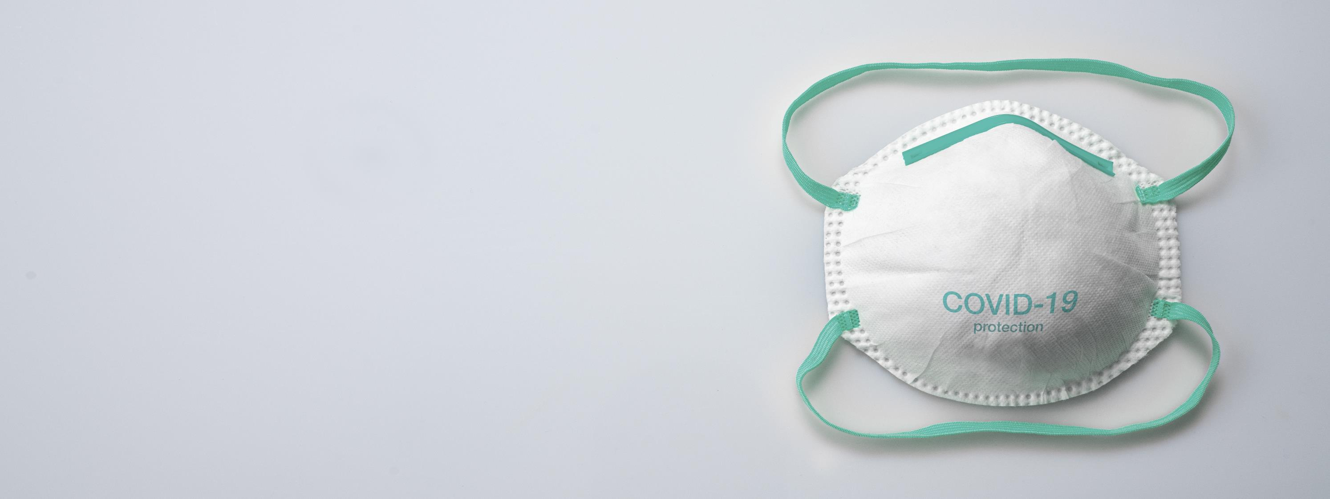
Kindness shown by others as a 'shielded' person in ensuring that we always had provisions.
When I had to put a mask on my child...
When my shoulder completely gave way from over working, spending 16 hours a day hunched over a laptop which led to me spending two miserable weeks lying on the floor, unable to move.

Slide 31

The sense of potential apocalypse early in the lockdown.
The lonely moments where the future looked very bleak.
Talking to people through windows.
Reduced freedom.
The sick feeling you get as you watch your company's revenue in freefall, sudden news of pay reductions and wondering if you'll be able to feed your family in a month’s time.....

Slide 32
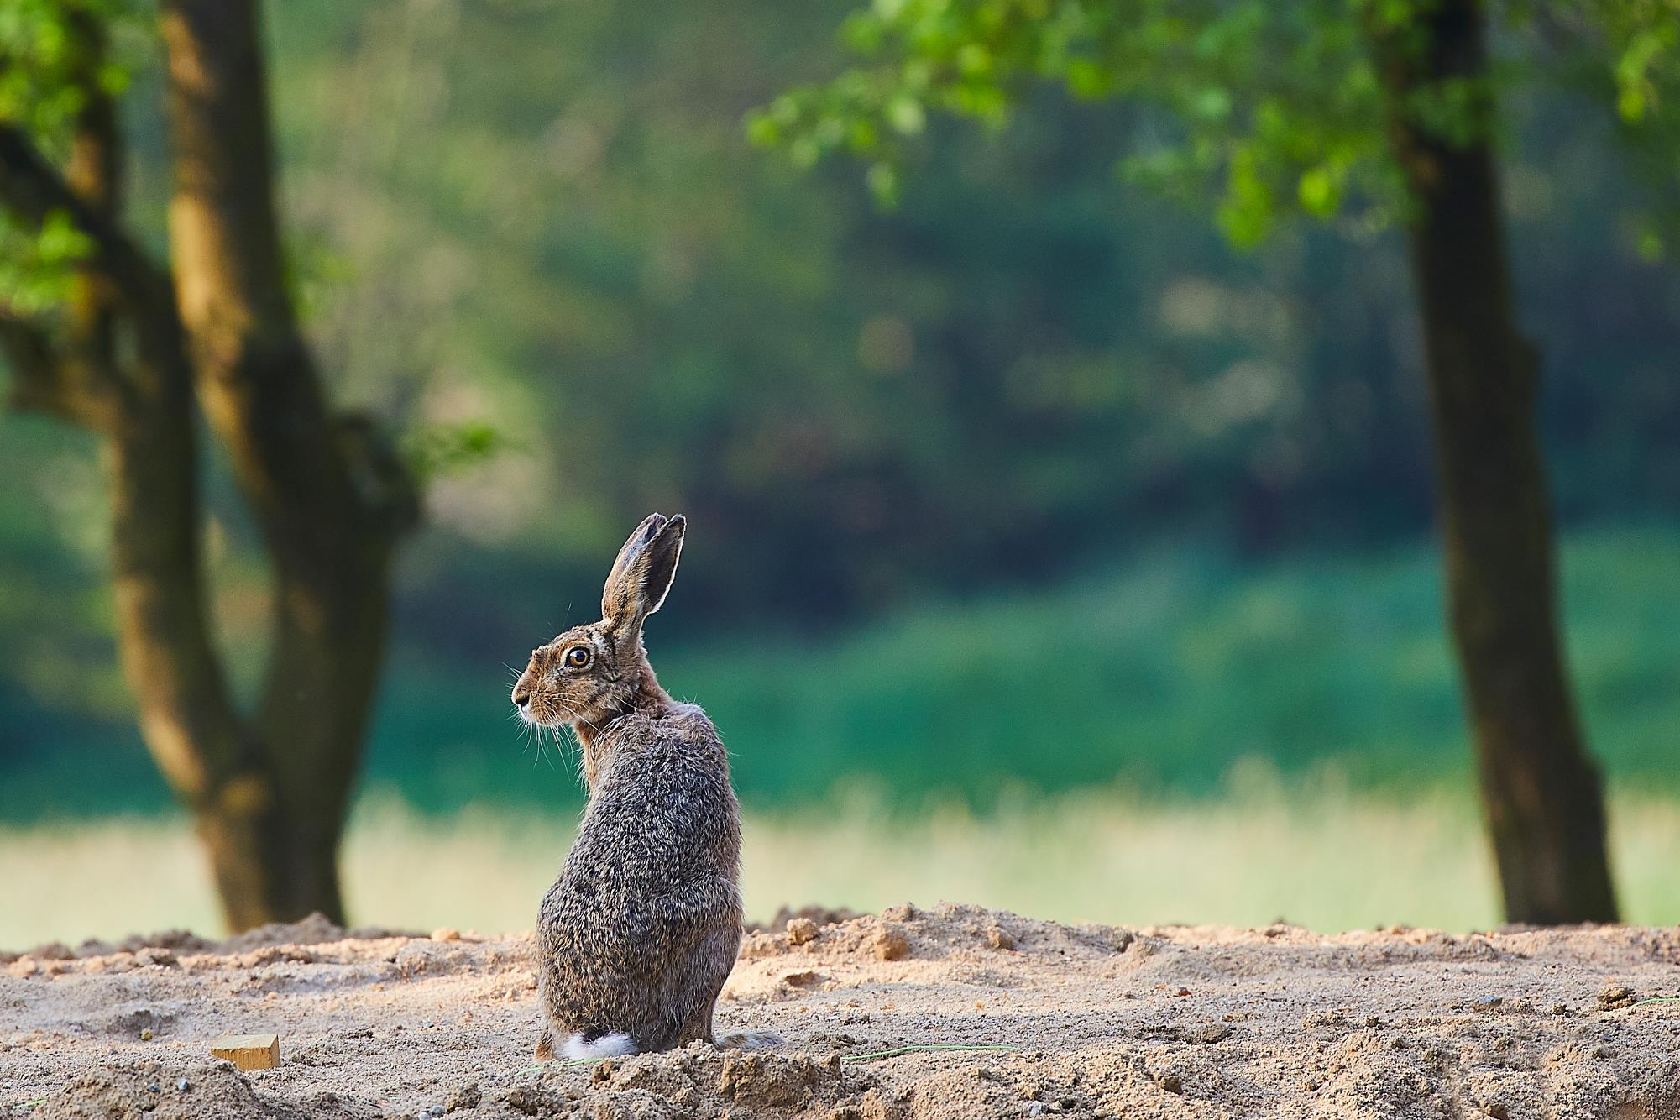
The emergence of wildlife.
The silence and clean air, the compassion.
Driving on the A1 and not seeing a single other car; it was like something out of an Armageddon movie!
Photos of London, Paris and New York empty.

Slide 33

Queuing for supermarkets only to find empty shelves!
Dress up theme nights! Matching the food (dinner), fancy dress & music to different countries/cultures.
It was my birthday at the end of April, so early on but at peak lockdown. I made rainbow cupcakes for all my neighbours (50 delivered to 25 houses) and my best friend appeared at the end of the driveway, music blasting from her car, for a lockdown dance party. That was pretty special!

Slide 34
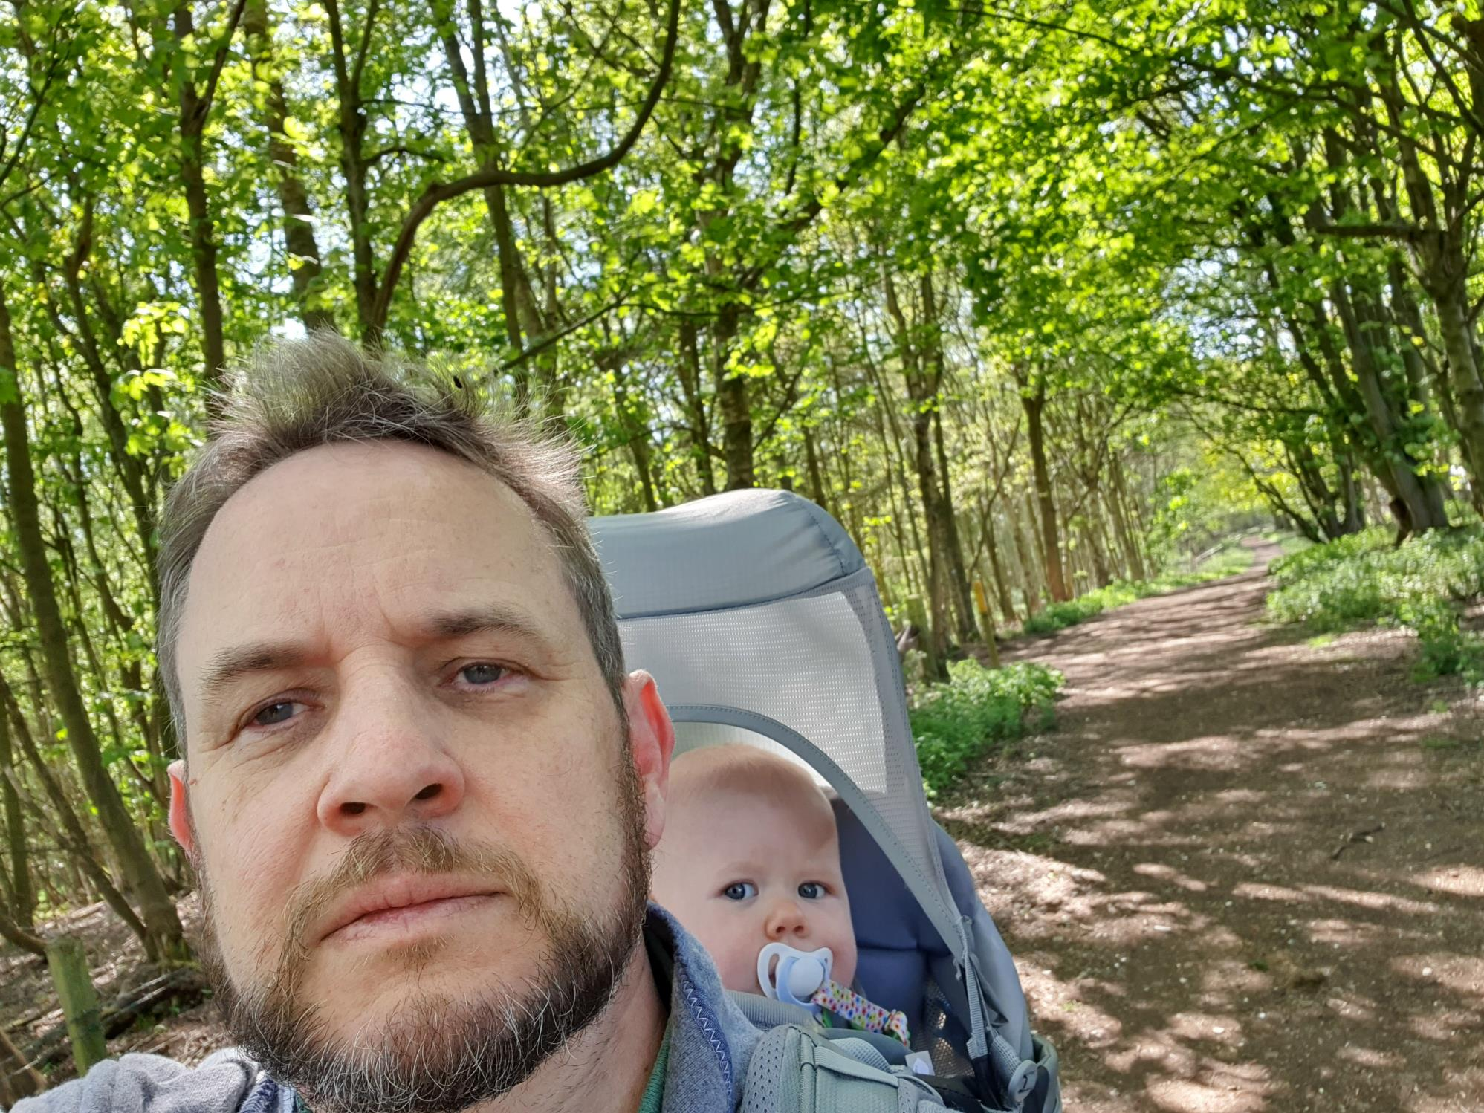
Unexpected extra time with my little one :)
Seeing my third child take their first steps.
Juggling home schooling while working on a large bid.
Long days - doing 9 to 3 as a teacher and all other hours [on my] normal job

Slide 35

Passing the APMP Practitioner exam.
A client requesting a hardcopy of the bid and two memory sticks to be delivered to their site office even though their site was closed.
Having all 120 people in my bidding function, including me, made redundant and replaced with 9 graduates who have never done bids. I will never forget the sense of disappointment, betrayal and disgust that bidding (expertise and experience) can be seen as so unvalued and disposable. "It's only project management with some questions thrown in, anyone can do it."

Slide 36

That moment when you realise what's really important in life - health, family and contentment.
I found love during COVID by reconnecting with a colleague from a previous job

Slide 37
How are you feeling personally right now?
A significant number of our peers are really struggling
19%
43%
Some are thriving
24%
A potential wellbeing crisis in our professional – as in society more generally
6%
8%
0
20
40
60
80
100

Slide 38
What have you learned during the crisis about yourself?
The need to be kind to myself.
To expect the unexpected.
I am more resilient than I thought I was.
We're all very flexible and adaptable.
I need to slow down more often.
I’m as bad a teacher as I thought I was...
I need social interaction more than I thought.
That I'm very grateful for where I live in the countryside; peace and quiet during lockdown meant I felt in quite a bubble away from it all.

Slide 39
You learn who can truly rely on. Lockdown has shown that when things go wrong, your friends turn out not to really be your friends, and virtual strangers become your good friends.
The gravity of recent events can't be underestimated. People cope in different ways and it's important for me to recognize, understand and work around that.
Growth mindset beats fixed mindsets.
The people you work with make the job, not the work you do.
A re-affirmation that strength, solidarity, family, ensuring happiness and making every day count are what matters and will get us through any crisis.
I can work from home and still manage my team; I have always trusted my team to get the job done, I have realized my need to see people is a personal need not a work discipline.

Slide 40

In relation to work: are there any things that are worrying you right now about the future?
Macro-economy / recession
Risk of redundancy / Companies hiring and firing at will
Will the major companies who do the procuring be brave enough not to stop?
How many opportunities there will be given some customers may be struggling financially?

Slide 41

Furloughed with no end date
Continuity of earnings. Will I lose my house in August?
Bonus payments for 2021
Clients that I work with may lose their jobs
A flooded candidate market might mean lower salaries offered
Effects on consultants with lots of newly redundant workers competing
Will IR35 still happen, thus be a double-whammy that will affect the contract market?

Slide 42

New lockdown
Health should I need to go back the office / commute
My own mental health
Balance of work to non-work hours - longer working days now
Being overworked
Maintaining energy
Restructure. I could go back to a different line manager / team / etc.
Being trapped in a job I hate because of the economic impact of COVID

Slide 43

Am I having the same impact on teams remotely that I did when working with them in person?
The ability to maintain long-term relationships with my internal clients and stakeholders
Lack of career opportunities / training
Getting a job outside my current organisation
Increased competition for jobs
I've loved working in an office environment all of my life and made many great friends over the years that way. I worry that younger generations will not have that experience. Feels quite sad!
Increased focus on price might make quality sections less important
Reduced investment in bid teams / reduced external expenditure

Slide 44

Long-term mental wellbeing of my staff if they are not working from home by choice
Unlikely there will be pay reviews or bonuses for sometime, so worrying about retaining talent
Colleagues who have been furloughed
How I'm going to manage my workload until I can recruit more people into my team
Headcount is down so a sudden spike in deal flow will be challenging to staff (and I expect this to happen).
Freezing of recruitment - I was about to recruit for a bid executive and that has been frozen now
Onboarding new team members remotely while still making it an inspiring experience for them
That we can't anticipate or be in control, so variables are hard to manage
Will I or my organisation get those little lucky breaks that make all the difference when times are challenging?

Slide 45

Brexit
Going back to normal where nobody thinks about the environment

Slide 46

For external providers: how are you finding the market for your services right now?
Difficult.
I have no work.
Limited and few people getting back to messages or emails.
Quieter as people are hanging off from making decisions on anything and everything!
It's still out there, but slightly hesitant. It will come back.
Very cautious but recovering.
Now increasing, thankfully.
OK. Some clients are doing just as much work as before but this might tail off over next few months once the impact of the virus / job cuts really hits.
Picking up very fast just over the last week! Sharp increase in enquiries.
Busy.
Increased opportunities to support live deals as in-house bid teams struggle with a virtual way of working.
Good - am regularly turning down work due to not having capacity.

Slide 47

For external providers: what percentage change have you seen in your earnings in the past three months compared to the same time last year?
EXTERNAL PARTNERS

Slide 48
Any other comments, ideas or tips for people working in bids / proposals?
Use this as a time to be more creative in bids, people are reading documents on line, give the audience something to get excited about.
Now seems a great time to be approaching clients who would/should be tendering and trying to hang on to them for a true contract period. People crave stability - we should be offering that and taking advantage of that.
Practice your presentations hard on video conference!
Be honest - if a client is being unreasonable (with say, deadlines): tell them
Bring in more bios, commitment statements and quotes from key stakeholders in your team to make proposals more personal, and show off the people the client will be working with - it may not be possible to get people together face to face.
Draw inspiration from these times. If we can continue to deliver winning bids during these unprecedented times, we can win in any environment.
Be a people person. Now more than ever. Respect everyone. Be kind. Behind all bids are sellers and buyers, and they're all human beings. Technology is great but people respond to people. Talk more. Smile more. Everyone's carrying a heavy load you know nothing about.
Focus even more on the future than ever, be proactive, innovate and be more customer focused.

Slide 49

Don’t listen to the noise of negative organisations and people in the industry saying things will change forever. Some things will change, but only drastically for those that are left behind. Blockbuster vs Netflix scenario.
Put boundaries in place on your time and energy.
Nothing new but even more important when working from home: set start and end times to your day, it is too easy to still be working on a bid at midnight if you have no other commitments.
Be even more organised than you were before! Be open to flexibility, adapt, accept changes.
It's important to take time out to exercise &/or meditate/write in a gratitude journal. It re-centres your thoughts & makes you more productive.
Stay healthy and grounded - do yoga every morning, stop to eat nourishing food, get fresh air and be kind to yourself.

Slide 50

Stick together. We’re so much stronger together! If you’re looking for work then let us all know so we can help. If your job is safe then help out others by sharing things you see, or writing recommendations.
Use this time to get training or accreditations and reconnect with your network.
Networks matter, and even more so in times of crisis as you need the support more and it's more difficult to onboard or build relationships remotely. Make time for this.
If you are struggling, ask for help and use your network.
Stay calm!
Keep on keeping on.

Slide 51
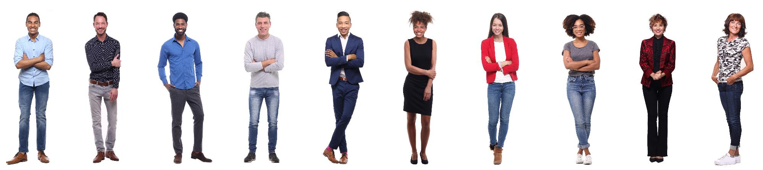
Vitally important to get together and discuss these topics and agree plans for the way forward depending on what you think the future may hold.
Never underestimate your value.
Hang on in there; we are nearly out the other side and career opportunities in our industry will skyrocket as demand for our services increases in this competitive market.
If the impacts of coronavirus have negatively impacted you, chances are that that your confidence, happiness, energy, hunger, drive, or sense of self-worth have dipped. Reignite your passions and energy by remembering who you are and what you stand for, what inspires you and what you want to achieve. Don't sell yourself short. You're worth more than you realise.

Slide 52
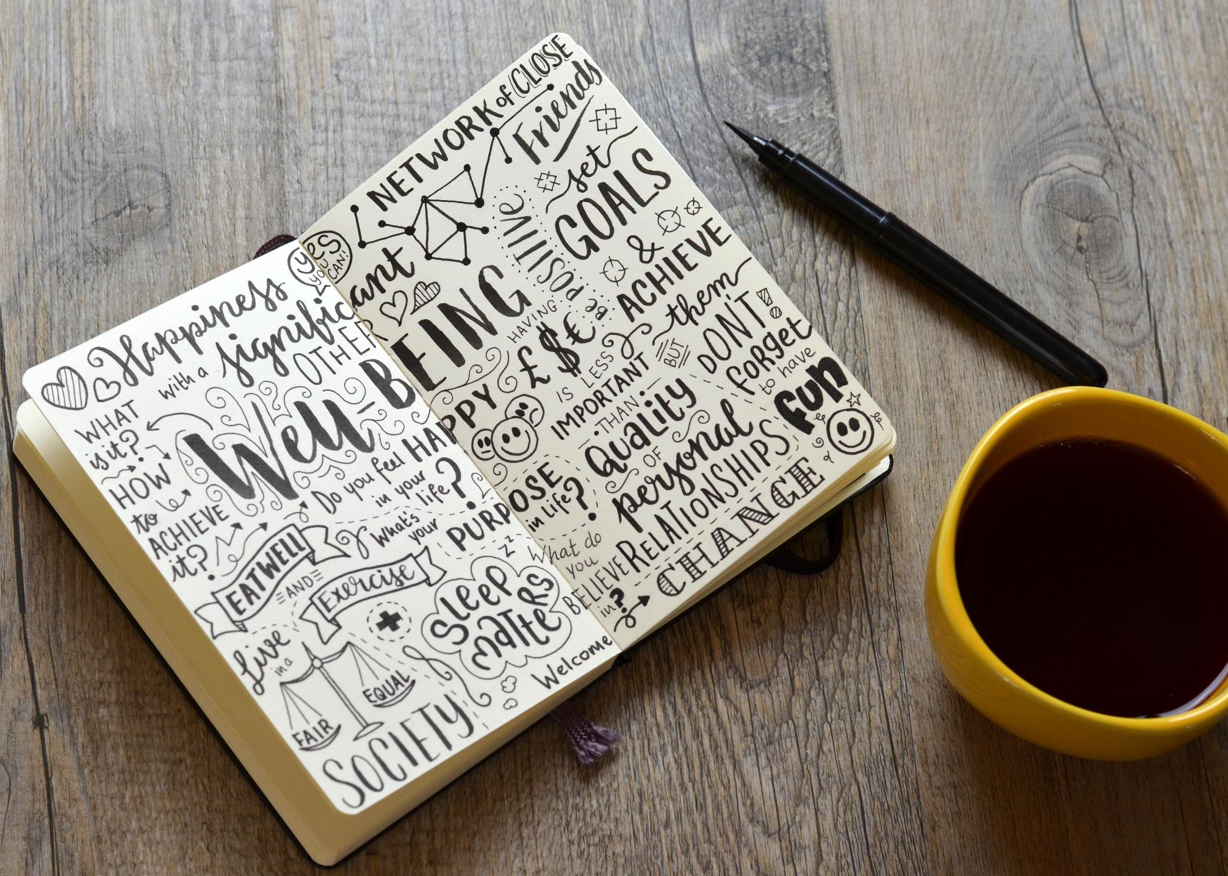
https://www.mind.org.uk/information-support/coronavirus/coronavirus-and-your-wellbeing/
https://www.moneysavingexpert.com/news/2020/03/uk-coronavirus-help-and-your-rights/
Shout: Text SHOUT to 85258 (text based helpline, for people who'd rather text than call.)
Samaritans: call 116 123
https://www.prevent-suicide.org.uk/find-help-now/stay-alive-app/
https://www.anxietycanada.com/resources/mindshift-cbt/

Slide 53

Feel free to share

Slide 54
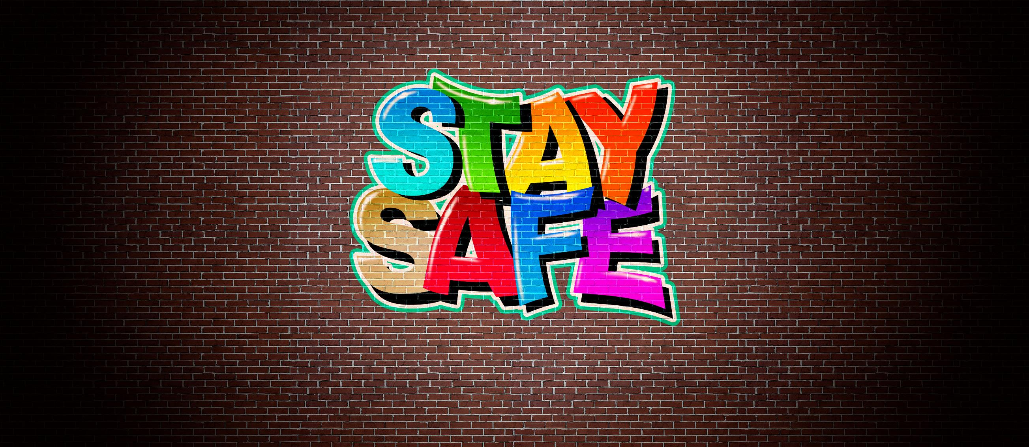

Slide 55


Thank you!
Jon Williams
jw@strategicproposals.com
+44 (0)781 333 2294
strategicproposals.com
proposalbenchmarker.com
@ProposalsSP

